Slide 1


Car Project
Made by Mario Slavov from 9A, Teodor Dimov from 9B, Petar Dyakov from 9V, Zhelyazko Ivanov from 9G

Slide 2
About the Team
Name | Role
Mario Nikolaev Slavov-9A | Developer
Teodor Boyanov Dimov-9B | Designer
Petar Mitkov Dyakov-9V | Developer
Zhelyazko Aleksandrov Ivanov-9G | Developer

Slide 3
About Project
We wanted to challenge ourselves and try to create something that makes the process of comprising a list of all existing cars in a car dealership and editing it far easier.
You can insert new cars, review the already existing list, edit the list and then delete them.

Slide 4
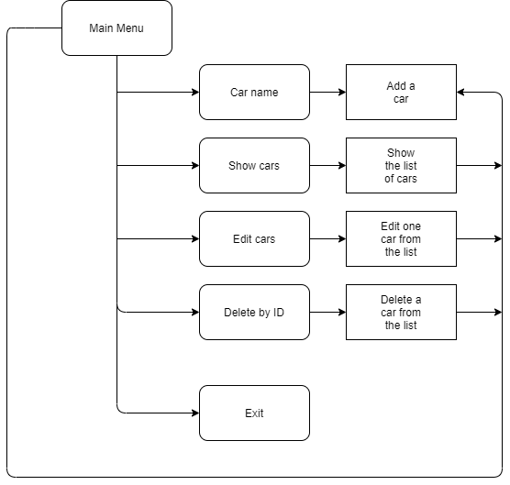
Logical Scheme

Slide 5


Used Technologies
z

Slide 6
Future Improvements
Make it usable for almost all car dealerships
Add more options for example:
ID randomizer
Log in / Sign up
Sorting
Etc.
Make it look more fancy

Slide 7

Thank you for the attention
z

